Slide 1

HDAG Siemens: Power Outage Prediction Models
Harvard Data Analytics Group
Spring 2022 Midpoint Presentation
May 12, 2022
Restricted

Slide 2
Introductions
Director of Consulting: Jonathan D’Souza
Case Team Leader: Catherine Huang
Associates: Michael Zhao, Sam Jones
Analysts: Andrew Li, Eugene Ye, Matthew Su, Saketh Mynampati, Tina Gong

Slide 3
Presentation Roadmap
1. Project Objectives, Model Architectures, APIs
Overview of project goals, our prediction and classification model architectures, and the APIs and auxiliary tools we used.
2. Model Progress (Midpoint)
Setup and performance of our models as of midpoint (early April).
3. Model Improvements
Current setup and performance of our models (with an emphasis on additions and performance improvements), and a walkthrough of the way our code is structured.
4. Q&A, Reflections, Next Steps
15-20 minutes for Q&A, reflections from analysts, feedback exchange, and discussion of next steps (including code handoff).

Slide 4
Project Objectives, Model Architectures, APIs
Overview of project goals, our prediction and classification model architectures, and the APIs and auxiliary tools we used.

Slide 5
Project Scope and Objectives
Brief overview of our client, the problems that this project aims to solve, and details about the scope and specifications of each part of our project.

Slide 6



Siemens Energy, Sensproducts™ Team
Sensproducts™ Team
IoT products for energy transmission equipment
Using data analytics to improve energy grid operation and management
Clients are power providers (through manufacturing transformers)
Use outage predictions from weather to inform power generation adjustments: generate more or less energy in advance of outage
Special interest in wind energy production: Siemens has large wind farm clients for whom they manufacture transformers
Also useful are consumer attitudes and sentiment post-outage, especially towards their local energy provider companies

Slide 7



Guiding Questions and Goals
For Siemens to receive a thorough and unbiased third-party perspective through HDAG, how can we undergo a well-informed public data collection process centered upon accessibility, reliability, consistency, and comprehensiveness?
For Siemens’ clients to act (i.e. operate differently on the energy grid) days in advance of an outage, can we predict the likelihood of an imminent outage given current weather, precipitation, and wind conditions?
For Siemens’ clients to better understand when and how to notify consumers early about power outages, can we pinpoint how power outages in impact individuals through changes in individual attitudes and sentiment?

Slide 8
Executive Summary
Research and Data Collection
Power outage history and historical weather (predictive modeling), news articles + social media (sentiment analysis)
Focus on MA: intricate open-source 2019 and 2020 outage history data from 3+ energy production sources
APIs: Visual Crossing, OpenWeather/PositionStack, Elevation, Twitter
Prediction Model
Predict likelihood of imminent outage, given feature vector of weather conditions and elevation
Features: temp, precip, snow, windspeed, elevation
Models: logistic regression, decision tree, support vector machine, random forest classifier
Classification Model
Predict failed energy equipment — i.e. which piece of equipment is most likely to fail, given that outage is already predicted to happen
Features: temp, precip, snow, windspeed, elevation
Models: logistic regression, decision tree, support vector machine, random forest classifier

Slide 9
Data Collection and APIs
All code is housed in the data-cleaning and weather-api-and-models Deepnote projects. The notebooks relevant to each slide are also linked in the top right corner of the slide.

Slide 10
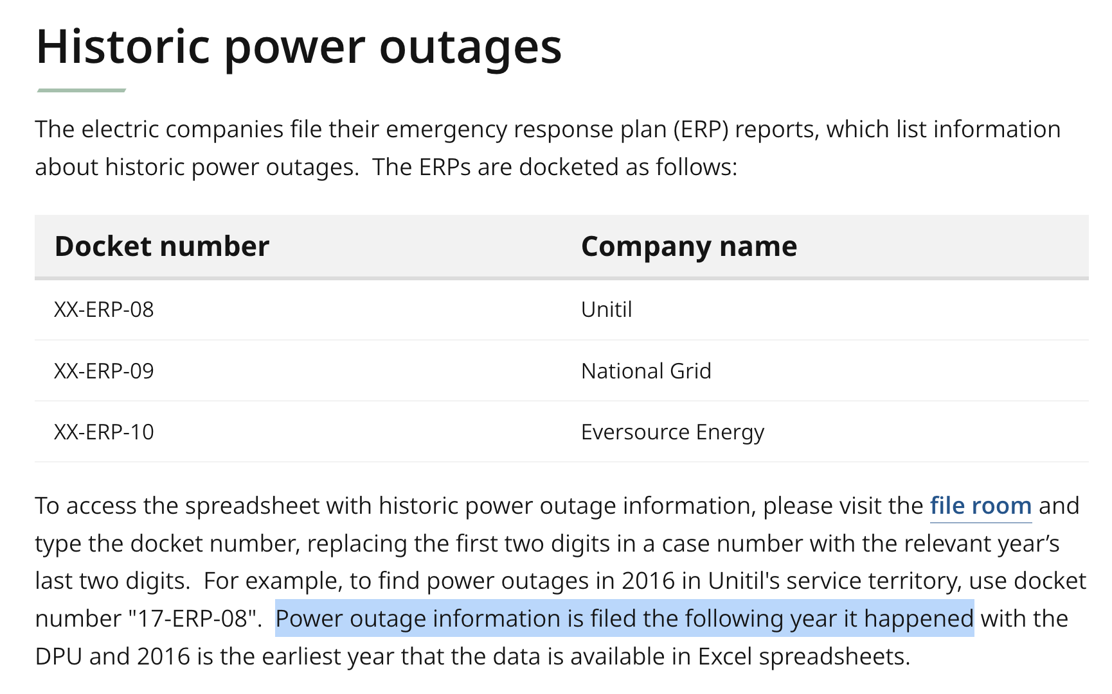
Power Outage History Data - Sources
Publicly accessible, directly from mass.gov
Through electric companies’ emergency response plan reports
Companies
Eversource Energy, National Grid, Unitil
Historical outage information only becomes available the following year it happened ⇒ we can only access information about outages in 2019 and 2020 (not 2021)
3 companies, 2 years each ⇒ 6 datasets merged

Slide 11
Power Outage History Data - Important Columns
1. Location and Timestamps
Location: city/town and street
Timestamps: date and time; granularity down to the minute; includes time in, time out, and duration
Used to fetch weather data at timestamp 1 hour prior
2. Customers Affected, Total Customers Outage Hours
i.e. total outage hours shared among all affected customers
Used to fine-tune training and test data – we exclude small-scale outages with trivial effect
3. Failed or Damaged Equipment
Lists the specific piece of failed or damaged equipment that brought about outage. Otherwise, lists “not applicable,” “unknown,” or “other”
Used as labels for failed equipment prediction model
4. Reason For Outage
Includes reasons such as animal, tree contact, equipment failure, loss of supply/improper installation
Used to fine-tune training and test data – we exclude outage entries with man-made (not natural) causes

Slide 12
Power Outage History Data - Data Cleaning Workflow
Original dataset
Remove outages not caused by nature (human, animal, etc.)
Remove outages with insignificant impact
“Failed or Damaged Equipment” labels changed (broader categories)
Reduced dataset
Re-formatted timestamp and location data
Final working dataset

Slide 13
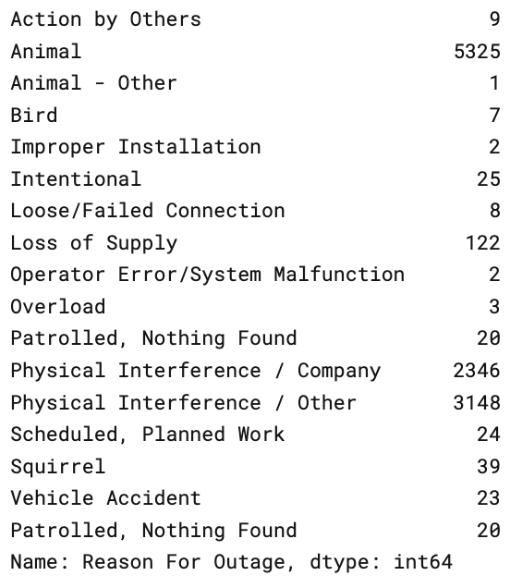
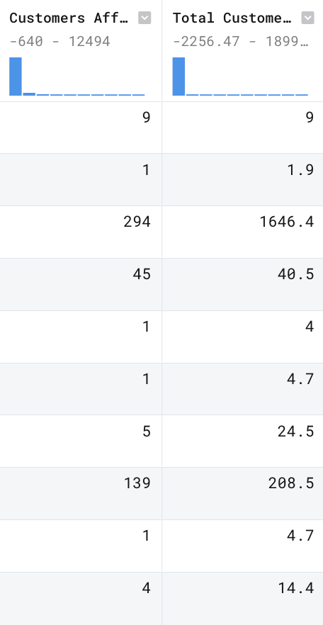
Data Cleaning: Removing Unsuitable Outages
Code notebook link: here
Original dataset (merged across 3 companies and 2 years): 60,177 rows
1. Removing man-made outages
A good number of rows have reasons for outage cited as unrelated to natural causes: scheduled or planned outages, animal interference, equipment setup faults, etc.
60,177 → 49,073 outages kept
2. Removing insignificant outages
Keep only the outages where:
Customers affected ≥ 30
Total customers outage hours ≥ 30
Threshold lowered from 100 (midpoint), 49,073 → 18817 outages kept
18,817: final dataset size

Slide 14

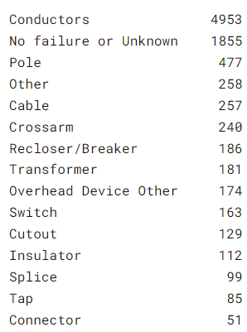
Data Re-Formatting
Code notebook link: here
Reducing failed equipment label set
Dataset populated with redundant equipment labels and labels with few (<10) samples
“No failure or Unknown,” “Unknown,” “Not Applicable”
Reduce label set so we have enough samples for model training and better accuracy
Generalize labels, merge redundancies (identical labels), leftover unique labels with few data points merged with “Other”
Result: 66 labels reduced to 15 (right)
Minimum 50 samples per label
Reformatting: latitude-longitude and Unix time
Visual Crossing and OpenWeather historical weather API take the following forms:
Location: in (latitude, longitude) coordinate pairs
Time: in Python DateTime object form, e.g. '2019-01-24 15:00:00'
Used PositionStack Geocoding API and Python DateTime module

Slide 15
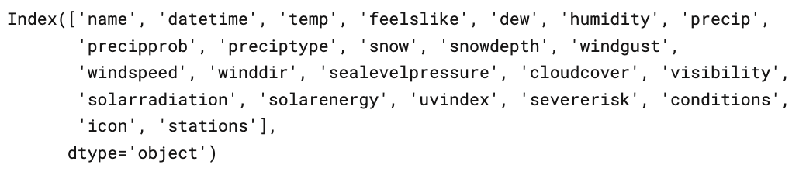
Primary APIs and Technical Stack
Auxiliary APIs
Outage Prediction
Visual Crossing API:
Historical weather
Features are pictured
We extracted weather from 1 hour before the reported power cutout time
Open-Elevation API:
Elevation feature in training set
Takes in latitude-longitude pair
Sentiment Analysis
Twitter API
Fetch timestamp, keywords, text content of public tweets
Auxiliary
PositionStack API
Geocoding: used to fetch latitude-longitude pairs given city/town names
Python reverse geocoder library (open-source, code here)
Used when creating control data (sampling random latitude-longitude coordinates within the Massachusetts)
Too costly APIs: OpenWeather historical weather API, webz.io historical news API

Slide 16
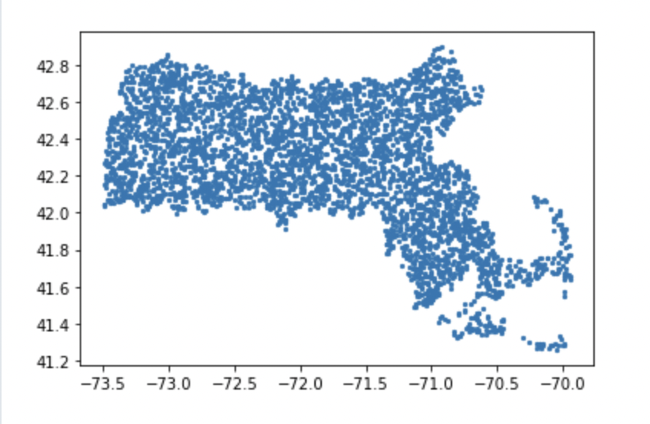
Control Group Data Collection
Code notebook link: here
Randomly selected locations in Massachusetts associated with a random time in 2019 or 2020.
Location: Uniform random sample of 10,000 coordinates within a rectangle containing MA
Threw out coordinates that were not actually within the state (using the Reverse Geocoder API)
Threw out coordinates that were not over land (using the Global Land Mask API)
Threw out coordinates that were too close (within 1 degree) to coordinates in the outage dataset
Time: Associated each coordinate with a random time from 2019 or 2020.
We then used the Visual Crossing API to get historical weather data for each point in our control group

Slide 17
Outage Likelihood and Equipment Prediction Model Frameworks

Slide 18

Model 1: Likelihood of Outage
Feature vectors and labels
Current features: temp, precip, snow, windspeed, elevation*
Labels: {0, 1}
This 0-1 prediction model seeks to predict how weather irregularities, and other (natural or human) catalysts bring about power outages. Find which phenomena are more or less likely to indicate imminent outage.
Models: Logistic regression with SAGA solver, support vector machine, random forest classifier
*elevation: post-midpoint
Model*
Likelihood in (0,1)
Predicted label in {0,1}

Slide 19

Model 2: Failed Equipment Given Outage
This multi-class prediction model seeks to, find which weather phenomena are more or less likely to be correlated with which pieces of equipment fail, given outage occurs.
Models: multiclass logistic regression with SAGA solver, support vector classification, random forest classifier
*elevation: post-midpoint
Feature vectors and labels
Current features: temp, precip, snow, windspeed, elevation*
Labels: equipment classes (1-15)
Model*
Predicted failed equipment class

Slide 20
Model Progress (Midpoint)
Setup and performance of our models as of midpoint (early April).
All code is housed in the data-cleaning and weather-api-and-models Deepnote projects. The notebooks relevant to each slide are also linked in the top right corner of the slide.

Slide 21
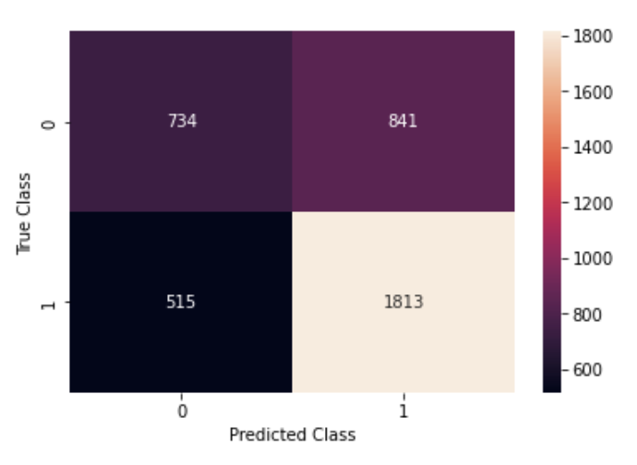
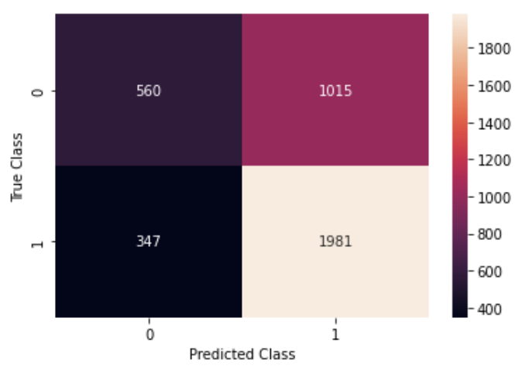
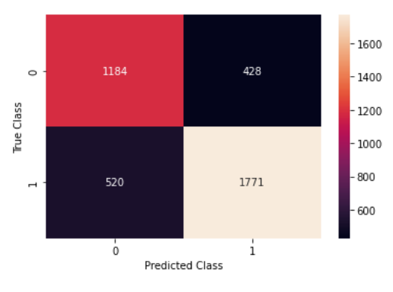
Model 1: Outage Likelihood
Code link: here
Confusion matrices:
Logreg (top) and SVM (middle): more false positives than false negatives - potential value
Solver: SAGA (stochastic average GD)
Max iterations: 100^3
Features: ['temp', 'precip', 'snow', 'windspeed']
Logistic regression: 0.653 test accuracy (improved after removing man-made outages, adding more features)
Support vector machine: 0.61
Random forest: 0.76
RF (bottom): balanced Type I and Type II errors

Slide 22
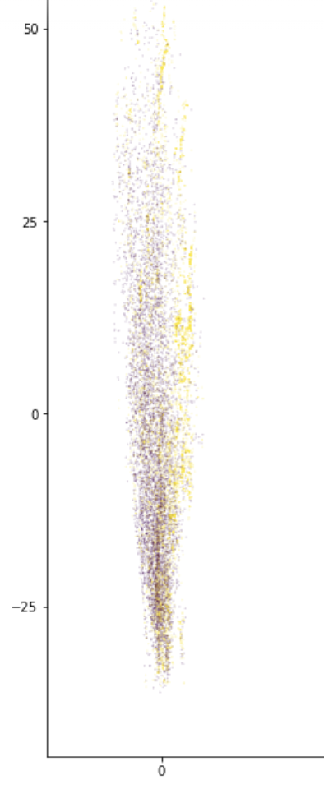
Lack of Separability
Classifying outages and type of outage has some fundamental roadblocks due to the nature of the problem.
Outages happen under a variety of conditions, and most extreme weather does not cause outages
Different types of equipment fail under similar conditions
Our main goal after midpoint was to look into this problem.
A scatterplot of the two principal components of the data. The data is very intermingled, and not clearly linearly separable.

Slide 23
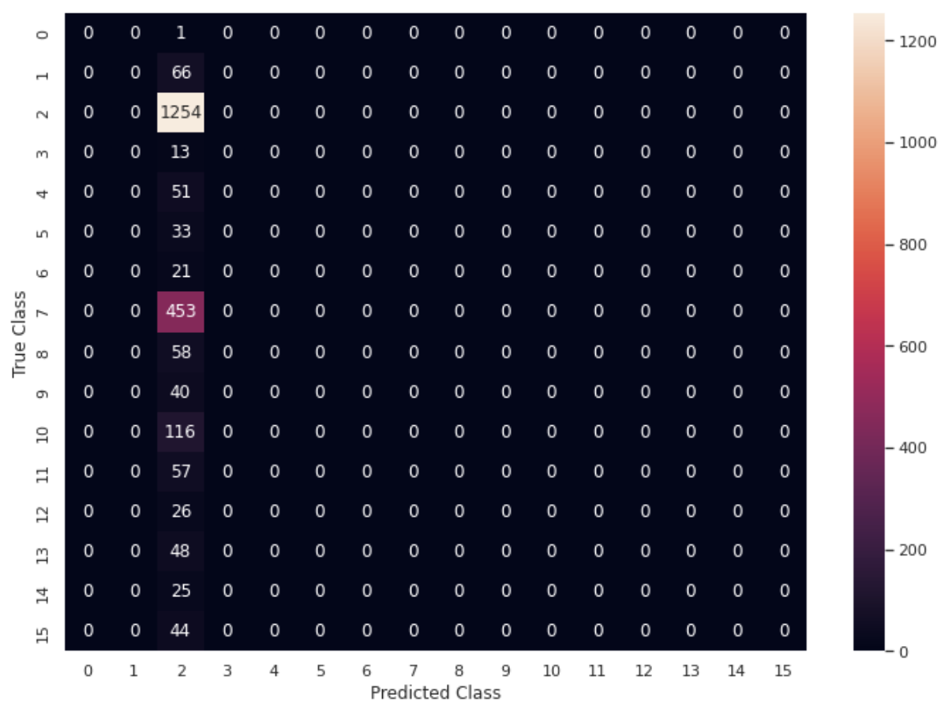
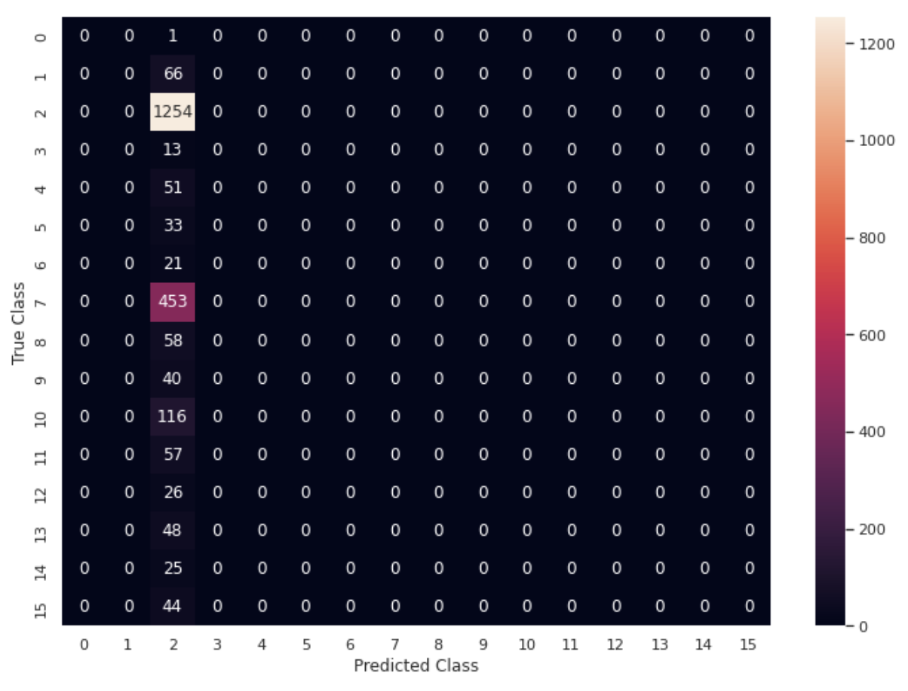
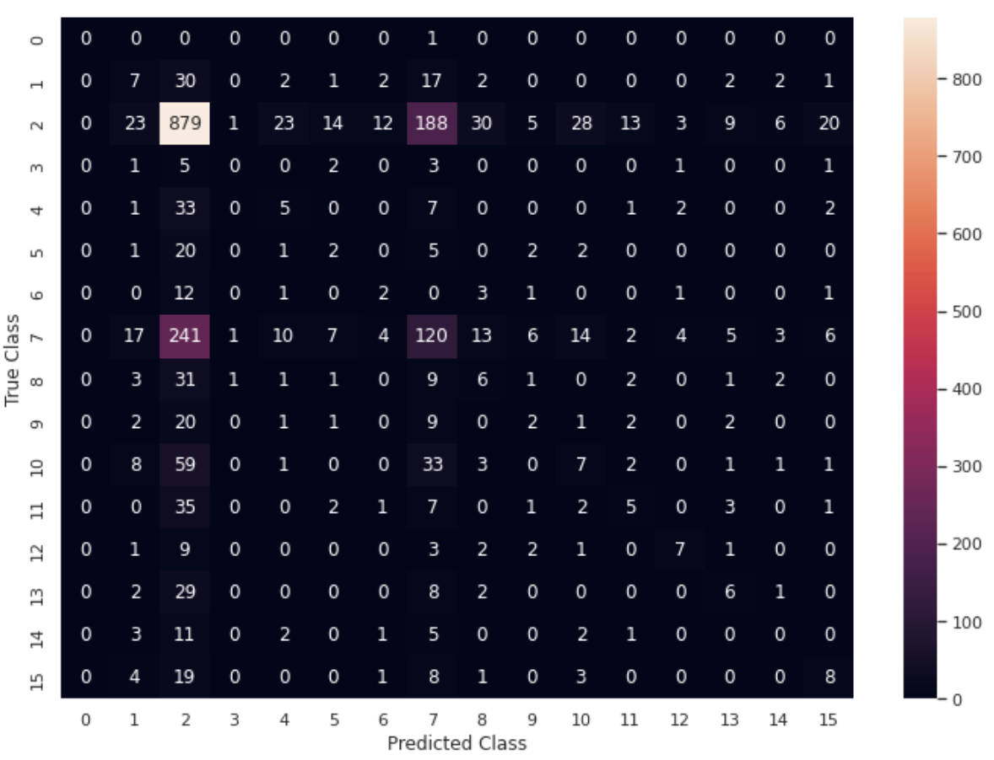
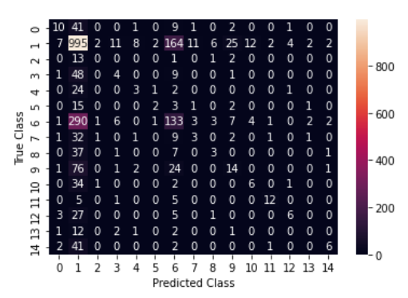
Model 2 (Failed Equipment):
Logistic Regression
Code link: here
Solver: SAGA (stochastic average GD)
Features: ['temp', 'precip', 'snow', 'windspeed']
Training data distribution: the largest class comprises 40% of training data
Logistic regression: 0.544 test accuracy
SVM: 0.544
Decision tree: 0.458
RF: 0.52
Confusion matrices: logreg* (top left), SVM* (top right), decision tree (bottom left), RF (bottom right)
*: misclassifications all pertain to one class: conductors

Slide 24
[Post-Midpoint] Model Improvements
Current setup and performance of our models (with an emphasis on additions and performance improvements), and a walkthrough of the way our code is structured.

Slide 25
Model Improvement Goals
1. More features
Other features to consider: time of year, seasonal indicators, elevation, terrain data - more features means higher chance of linear separability
Conflate existing feature set with weather from more hours back
2. Conceptual considerations
Alternative architectures: non-linear classifiers such as generative models and neural networks
Overfitting prevention: explicit regularization and/or decision tree pruning
4. More data
Examples: adjust the minimum outage size cutoff (right now it’s 100 for both metrics), use a larger or different failed equipment feature set, use data from more U.S. states (this increases utility of model as well)
3. Adjust control data collection process
Collect more data points so training data for 0-1 model is uniformly distributed across labels
More diverse location and timestamp sampling

Slide 26
Lowering Outage Magnitude Threshold
Recall that as of midpoint, we only keep outages where customers affected ≥ 100 and total customers outage hours ≥ 100
We changed that threshold to 30, for a new dataset size of 18817 (rather than 9222)
Did not directly improve model performance on its own

Slide 27
Using Terrain Data
Explored adding terrain as a new feature for model
Accounts for physical attributes of the land itself and could explain differences between closely spaced but physically different locations
Climate (Köppen)
Based on temperature and precipitation, which have already been considered
Elevation, Slope, Orientation, Relief
Will consider elevation
No effective tools for calculating slope and orientation for a large number of locations
Considered accounting for relief by using color of relief map, but potentially too imprecise

Slide 28
Generating More Control Data Points
In order to improve the accuracy of our models, we decided to expand the dataset in hopes of better approximating the ground truth of the weather distributions generating outages.
We expanded the size of the control dataset from sampling 10000 points to sampling 40000 points
Dataset expansion alone increased outage prediction model accuracy to 82% (from previous 63%) for the logistic regression- however, the logistic regression predictions are still fairly imbalanced
The Random Forest model’s accuracy improved marginally to 78% from 76%
This process took considerable time due to API limitations - the geocoding and weather data generation
Sampling and checking 40000 points took 12-24+ hours
Extracting weather data for each of those points took yet longer

Slide 29
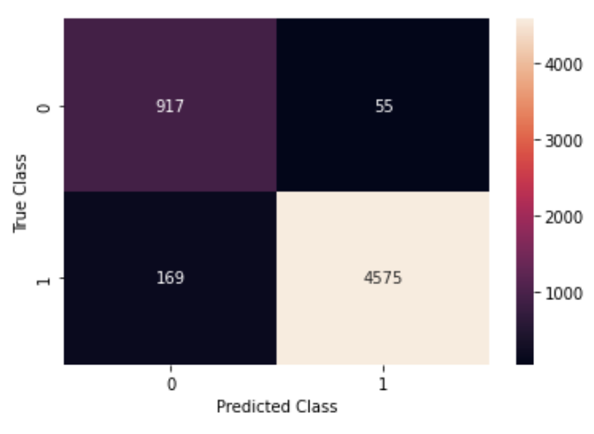
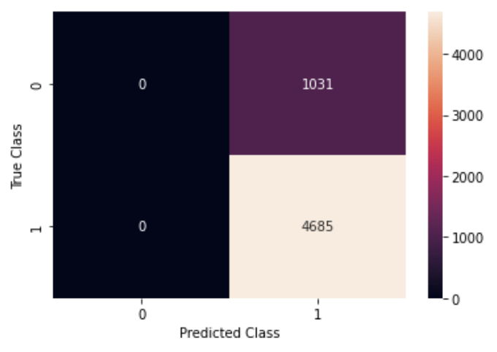
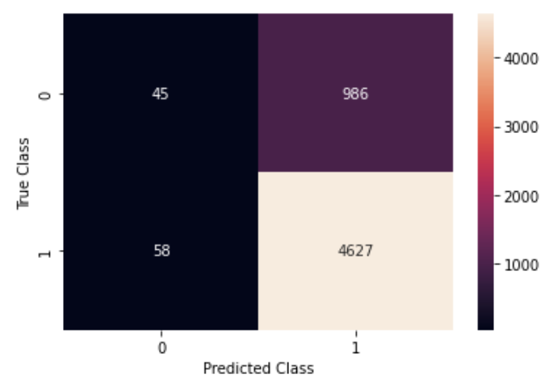
Adding Elevation as a Feature: Outage Prediction Model
Open-Elevation API: docs and source here
Accuracy spiked to ~96% from ~75% for prediction task
Normalization of elevation column did not improve accuracy (~75% → ~82%)
Same accuracy as that after we expanded dataset
Is elevation truly effective?
May serve as geocoding for each location
I.e. only one population center with elevation of exactly 450 feet.
If API isn’t precise, a whole town may have equal elevation → all points in area have same elevation, model interprets as a geocode to town
Confusion matrices on test sets: to the right
Logreg without normalization: 96.08% accuracy, balanced Type I and Type II errors
SVM with normalization: 81.96% accuracy, all false positives (not a useful model)
Logreg with normalization: 81.73% accuracy, more false positives

Slide 30
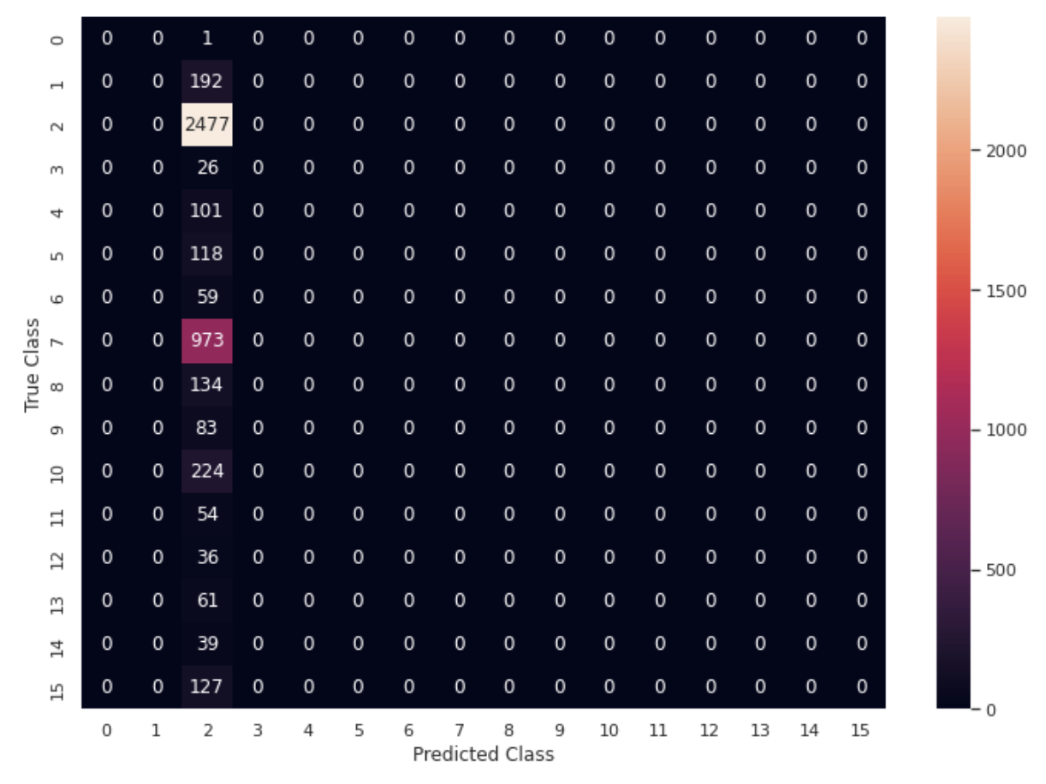

Adding Elevation as a Feature: Equipment Classification Model
Again used Open-Elevation API, normalized
Generally did not improve accuracy
Logistic regression: 54.4% → around 53% (varies on each run)
Decision tree: 45.8% → 46.9%
SVM: same performance as logreg
RF: unable to run given our software and larger outage dataset size (Jupyter kernel crashed – too much memory usage)
Analysis
Elevation: not helpful (essentially no effect on model performance)
Elevation => overfitting => low test accuracy?
Relative usefulness of the models remained the same – decision tree had lower performance but more usefulness
Logreg and SVM with normalized: same behavior (classifying all into one class)
DTree and RF: more useful (actual decision boundaries)

Slide 31
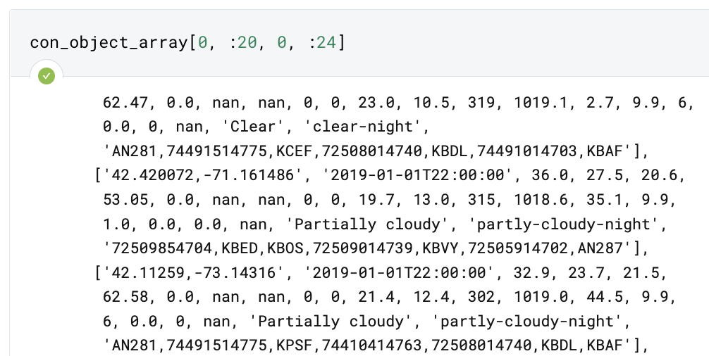
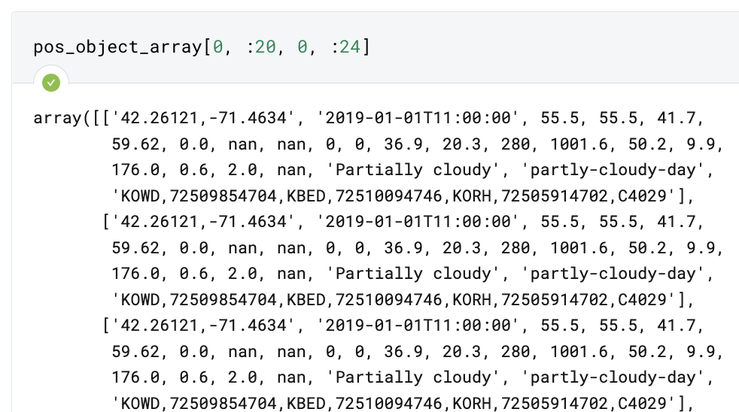
Recurrent Neural Networks on Time Series Data
We created a dataset of 12 hours worth of weather data for each outage or control point + timestamp
Did the same for 6 hours
Built a vanilla RNN architecture
Have not yet gotten around to training the model
Code notebook: here
Array representations of 12-hour data

Slide 32

Sentiment Analysis
Twitter API research
Developer Account is free for everyone
Queries are very niche and hard to access actual tweets
Free developer account grants you access to tweets from past 7 days
Premium account grants access to archive since 2006
Requires application to gain access (do not know the cost)
The API itself seems pretty simple to use
Extremely popular and widely used to there are many tutorials and guides
The only drawback is the information that twitter gives you access to – mostly used to create twitter bots
Our team has been working on gaining premium account access

Slide 33
Further Work
For continued work on this project.

Slide 34
Further Work 1: Using More Data
Use more states’ data as our training set
Specifically, use neighboring state(s) as test dataset to see how model generalizes
Coastal states (CA/NY), hotter states (Texas), midwestern states (Iowa)
This would involve the following:
Find the outage datasets from online, run the data cleaning code pipeline (might need to make adjustments specific to these datasets), run the control data generation pipeline, and run the weather APIs to get the relevant features out of both data groups (control and outage)
Problem: API access expired (as of late April)
Use more hours of data (higher-dimensional encoding)
We started this (through accessing 6- and 12- hour data, attempting RNNs)
Future team members on this project can build off of this analysis
Use even larger control dataset, optimize the control/outage dataset size ratio
For 18817 outages, 4047 control data points is still not a lot

Slide 35
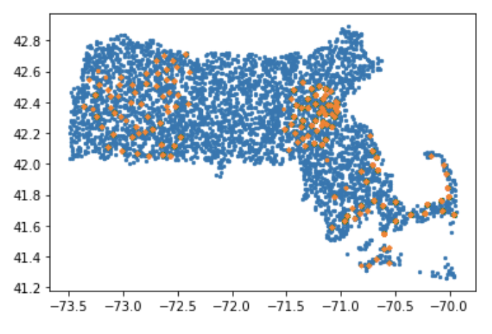
Further Work 2: Change Control Data Generation Procedure
Currently, we pull control points that aren’t near recorded outages in order to make sure that we don’t have points in the control set.
For consistency and robustness, it is likely better to use control data from the same location as outage data, just different times
We plan to add more time controls to scan times near the outages to try to differentiate between extreme weather and extreme weather which leads to outages
We also plan to tune the control/outage balance (dataset size) to try to determine what balance works the best to adjust for the vast majority of real-world cases not being outages
Problem: API access expired (as of late April)
Current implementation:
Orange: reported outage locations
Blue: control point locations

Slide 36



Further Work 3: Sentiment Analysis Research
Unsupervised learning using NLP libraries (NLTK, SpaCy, TextBlob)
Look at searches, social media posts, and news articles—especially blurbs that mention wind provider companies
Pay most attention to findings about individual sentiment that can lead to actionable insights for companies

Slide 37
Q&A, Reflections, Next Steps
15-20 minutes for Q&A, reflections from analysts, feedback exchange, and discussion of next steps (including code handoff).

Slide 38
Q&A

Slide 39
Thank you!
Thank you for a wonderful semester!

